Slide 1
Quick Summary of Spike-based Error-Backprop for Deep SNN
Yingyezhe Jin

Slide 2
Current Best Results
Network topology:
28x28 - 400 - 10 (MNIST)
34x34 - 800 - 10 (NMNIST)
MNIST Dataset (Poisson rate code)
60,000 for training, 10,000 for testing
Best performance: 98.46% (98.42% for 28x28 – 800 – 10 )
Run time for one iteration @CPU: 7 Hours
Neuromorphic MNIST Dataset
Best performance: 97.89% (97.7% for 34x34x2 – 800 - 10)
Run time for one iteration @CPU: 10 Hours
Target Performance:
98.6%

Slide 3



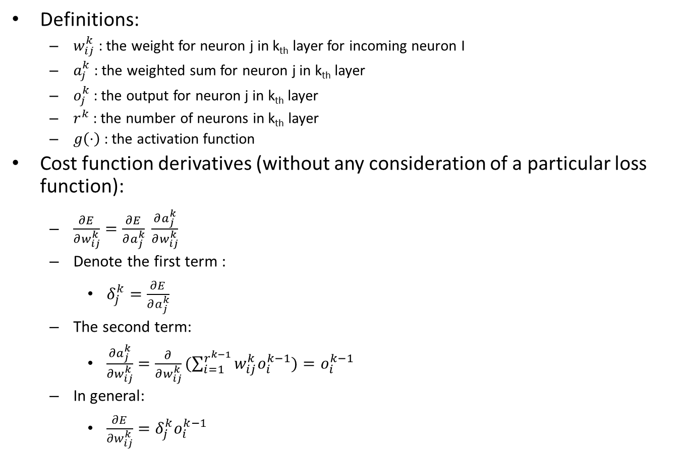





How to do backprop in ANN?
Definitions:
$w_{ij}^{k}$ : the weight for neuron j in k_{th} layer for incoming neuron I
$a_{j}^{k}$ : the weighted sum for neuron j in k_{th} layer
$o_{j}^{k}$ : the output for neuron j in k_{th} layer
$r_{}^{k}$ : the number of neurons in k_{th} layer
$g\left(⋅\right)$ : the activation function
Cost function derivatives (without any consideration of a particular loss function):
$\frac{∂E}{∂w_{ij}^{k}}=\frac{∂E}{∂a_{j}^{k}} \frac{∂a_{j}^{k}}{∂w_{ij}^{k}}$
Denote the first term :
$δ_{j}^{k}=\frac{∂E}{∂a_{j}^{k}}$
The second term:
$\frac{∂a_{j}^{k}}{∂w_{ij}^{k}}=\frac{∂}{∂w_{ij}^{k}}(\sum_{i=1}^{r^{k−1}}{w_{ij}^{k}o_{i}^{k−1})}=o_{i}^{k−1}$
In general:
$\frac{∂E}{∂w_{ij}^{k}}=δ_{j}^{k}o_{i}^{k−1}$
$$o_{i}^{k−1}$$
$$a_{j}^{k}$$
$$δ_{j}^{k}$$
Usually called Error
$$i$$
$$w_{ij}^{k}$$
$$j$$
$$o_{j}^{k}$$
$$k$$

Slide 4



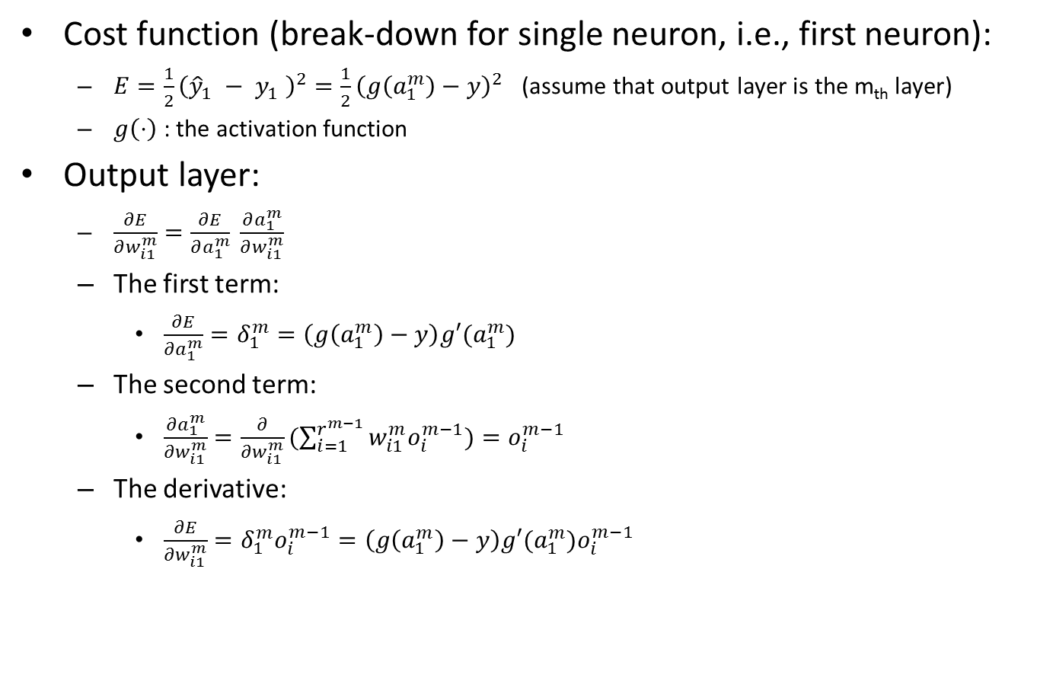




How to do backprop in ANN?
Cost function (break-down for single neuron, i.e., first neuron):
$E=\frac{1}{2}{\left({\hat{y}}_{1} − y_{1} \right)}^{2}=\frac{1}{2}{\left(g\left(a_{1}^{m}\right)−y\right)}^{2}$ (assume that output layer is the m_{th} layer)
$g\left(⋅\right)$ : the activation function
Output layer:
$\frac{∂E}{∂w_{i1}^{m}}=\frac{∂E}{∂a_{1}^{m}} \frac{∂a_{1}^{m}}{∂w_{i1}^{m}}$
The first term:
$\frac{∂E}{∂a_{1}^{m}}=δ_{1}^{m}=\left(g\left(a_{1}^{m}\right)−y\right)g′(a_{1}^{m})$
The second term:
$\frac{∂a_{1}^{m}}{∂w_{i1}^{m}}=\frac{∂}{∂w_{i1}^{m}}(\sum_{i=1}^{r^{m−1}}{w_{i1}^{m}o_{i}^{m−1})}=o_{i}^{m−1}$
The derivative:
$\frac{∂E}{∂w_{i1}^{m}}=δ_{1}^{m}o_{i}^{m−1}=\left(g\left(a_{1}^{m}\right)−y\right)g′(a_{1}^{m})o_{i}^{m−1}$
$$o_{i}^{m−1}$$
$$a_{1}^{m}$$
$$δ_{1}^{m}$$
$$i$$
$$w_{i1}^{m}$$
$$1$$
$$o_{1}^{m}$$
$$m$$

Slide 5

How to do backprop in ANN?
Hidden layer
$\frac{∂E}{∂w_{ij}^{k}}=\frac{∂E}{∂a_{j}^{k}} \frac{∂a_{j}^{k}}{∂w_{ij}^{k}}$
The first term :
$δ_{j}^{k}=\frac{∂E}{∂a_{j}^{k}}=\sum_{l=1}^{r^{k+1}}{\frac{∂E}{∂a_{l}^{k+1}}}\frac{∂a_{l}^{k+1}}{∂a_{j}^{k}}$
$\frac{∂E}{∂a_{l}^{k+1}}=δ_{l}^{k+1}$
$a_{l}^{k+1}=\sum_{j=1}^{r^{k}}{w_{jl}^{k+1}g(a_{j}^{k})}$
$\frac{∂a_{l}^{k+1}}{∂a_{j}^{k}}=w_{jl}^{k+1}g′(a_{j}^{k})$
$δ_{j}^{k}= \sum_{l=1}^{r^{k+1}}{δ_{l}^{k+1}}w_{jl}^{k+1}g^{′}\left(a_{j}^{k}\right)=g^{′}\left(a_{j}^{k}\right)\sum_{l=1}^{r^{k+1}}{δ_{l}^{k+1}}w_{jl}^{k+1}$
$\frac{∂a_{j}^{k}}{∂w_{ij}^{k}}=o_{i}^{k−1}$
The derivative:
$\frac{∂E}{∂w_{ij}^{k}}=δ_{j}^{k}o_{i}^{k−1}=g^{′}\left(a_{j}^{k}\right)o_{i}^{k−1}\sum_{l=1}^{r^{k+1}}{δ_{l}^{k+1}}w_{jl}^{k+1}$
$$o_{i}^{k−1}$$
$$a_{j}^{k}$$
$$δ_{j}^{k}$$
$$i$$
$$w_{ij}^{k}$$
$$j$$
$$o_{j}^{k}$$
$$k$$
Back-propagated error

Slide 6




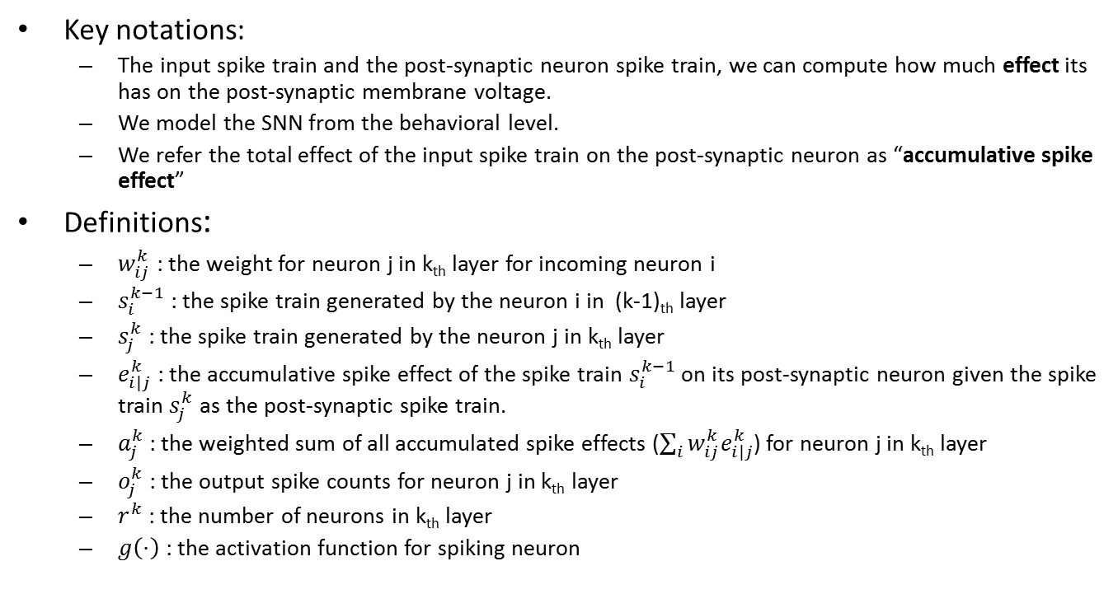






How to do backprop in SNN?
Key notations:
The input spike train and the post-synaptic neuron spike train, we can compute how much effect its has on the post-synaptic membrane voltage.
We model the SNN from the behavioral level.
We refer the total effect of the input spike train on the post-synaptic neuron as “accumulative spike effect”
Definitions:
$w_{ij}^{k}$ : the weight for neuron j in k_{th} layer for incoming neuron i
$s_{i}^{k−1}$ : the spike train generated by the neuron i in (k-1)_{th} layer
$s_{j}^{k}$ : the spike train generated by the neuron j in k_{th} layer
$e_{i|j}^{k}$ : the accumulative spike effect of the spike train $s_{i}^{k−1}$ on its post-synaptic neuron given the spike train $s_{j}^{k}$ as the post-synaptic spike train.
$a_{j}^{k}$ : the weighted sum of all accumulated spike effects ($\sum_{i}{w_{ij}^{k}e_{i|j}^{k}}$) for neuron j in k_{th} layer
$o_{j}^{k}$ : the output spike counts for neuron j in k_{th} layer
$r_{}^{k}$ : the number of neurons in k_{th} layer
$g\left(⋅\right)$ : the activation function for spiking neuron
$$k$$
$$o_{i}^{k−1}$$
$$a_{j}^{k}$$
$$w_{ij}^{k}$$
$$o_{j}^{k}$$
$$δ_{j}^{k}$$
$$i$$
$$e_{i|j}^{k}$$
$$j$$
$$s_{i}^{k−1}$$
$$s_{j}^{k}$$

Slide 7




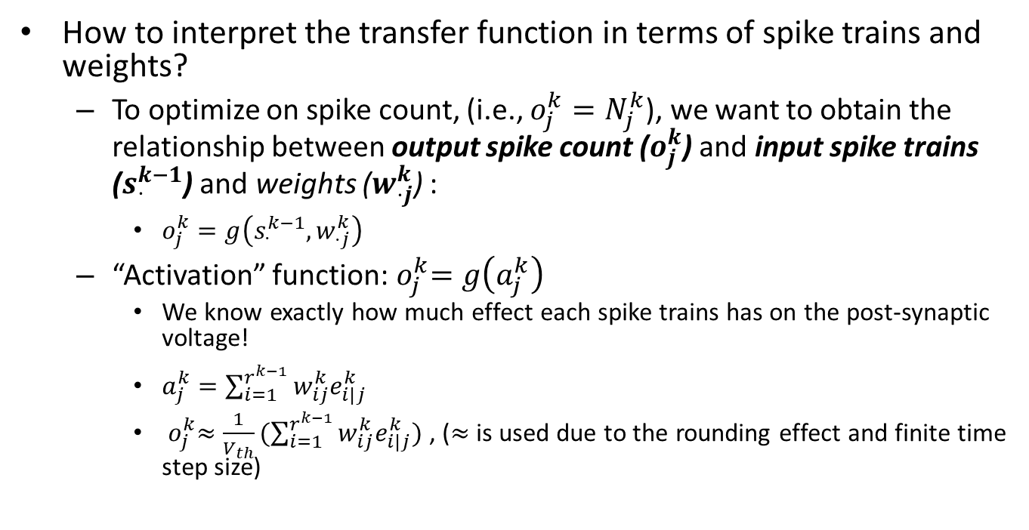






How to do backprop in SNN?
How to interpret the transfer function in terms of spike trains and weights?
To optimize on spike count, (i.e., $o_{j}^{k}=N_{j}^{k}$), we want to obtain the relationship between output spike count ($o_{j}^{k}$) and input spike trains ($s_{⋅}^{k−1}$) and weights ($w_{⋅j}^{k}$) :
$o_{j}^{k}=g\left(s_{⋅}^{k−1},w_{⋅j}^{k}\right)$
“Activation” function:${ o}_{j}^{k}=g\left(a_{j}^{k}\right)$
We know exactly how much effect each spike trains has on the post-synaptic voltage!
$a_{j}^{k}=\sum_{i=1}^{r^{k−1}}{w_{ij}^{k}e_{i|j}^{k}}$
${ o}_{j}^{k}≈\frac{1}{V_{th}}(\sum_{i=1}^{r^{k−1}}{w_{ij}^{k}e_{i|j}^{k}})$ , ($≈$ is used due to the rounding effect and finite time step size)
$$k$$
$$o_{i}^{k−1}$$
$$a_{j}^{k}$$
$$w_{ij}^{k}$$
$$o_{j}^{k}$$
$$δ_{j}^{k}$$
$$i$$
$$e_{i|j}^{k}$$
$$j$$
$$s_{i}^{k−1}$$
$$s_{j}^{k}$$

Slide 8
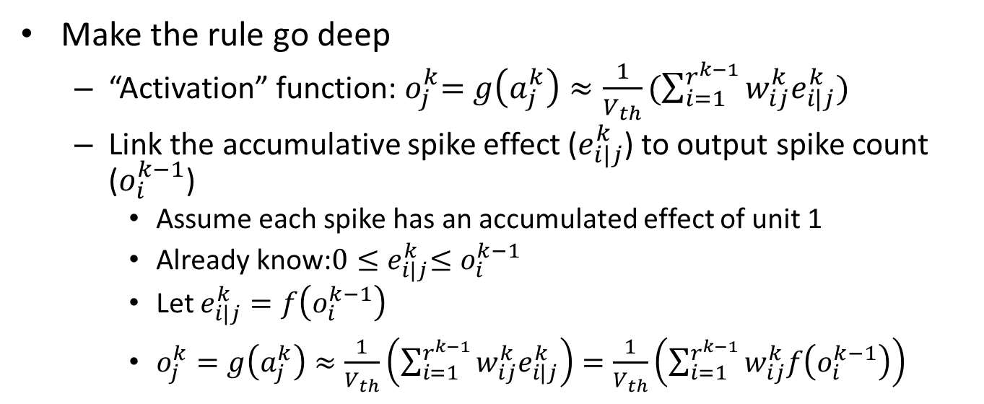
How to do backprop in SNN?
Make the rule go deep
“Activation” function:${ o}_{j}^{k}=g\left(a_{j}^{k}\right)≈\frac{1}{V_{th}}(\sum_{i=1}^{r^{k−1}}{w_{ij}^{k}e_{i|j}^{k}})$
Link the accumulative spike effect ($e_{i|j}^{k}$) to output spike count ($o_{i}^{k−1}$)
Assume each spike has an accumulated effect of unit 1
Already know:$0{≤e}_{i|j}^{k}≤o_{i}^{k−1}$
Let $e_{i|j}^{k}=f\left(o_{i}^{k−1}\right)$
$o_{j}^{k}=g\left(a_{j}^{k}\right)≈\frac{1}{V_{th}}\left(\sum_{i=1}^{r^{k−1}}{w_{ij}^{k}e_{i|j}^{k}}\right)=\frac{1}{V_{th}}\left(\sum_{i=1}^{r^{k−1}}{w_{ij}^{k}f\left(o_{i}^{k−1}\right)}\right)$
$$k$$
$$o_{i}^{k−1}$$
$$a_{j}^{k}$$
$$w_{ij}^{k}$$
$$o_{j}^{k}$$
$$δ_{j}^{k}$$
$$i$$
$$e_{i|j}^{k}$$
$$j$$
$$s_{i}^{k−1}$$
$$s_{j}^{k}$$

Slide 9





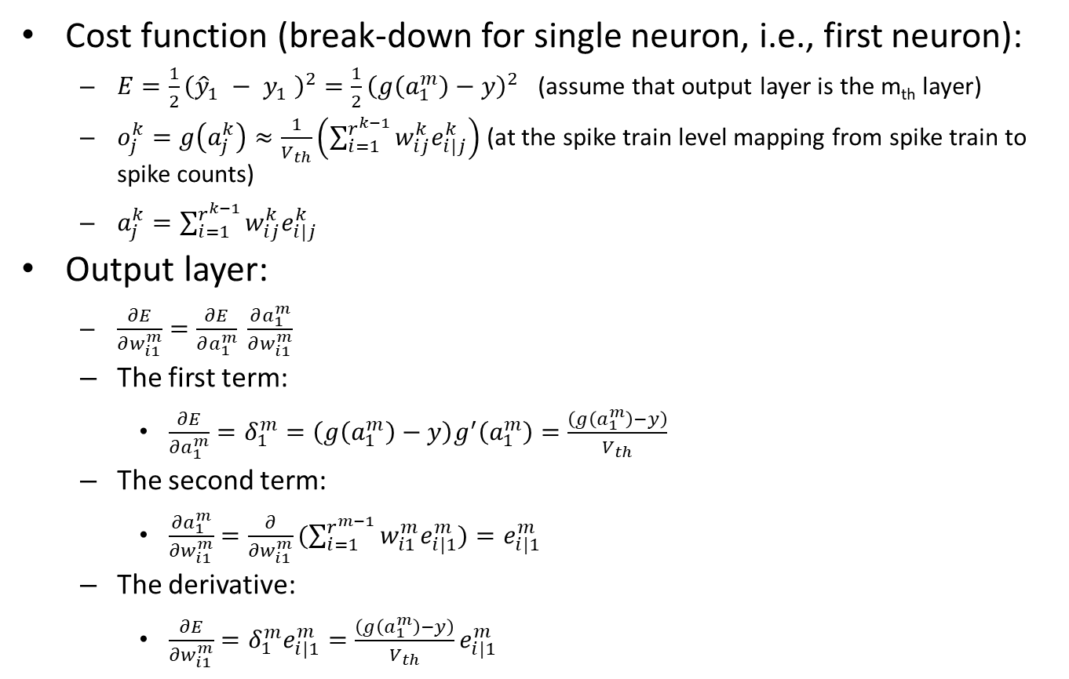





How to do backprop in SNN?
Cost function (break-down for single neuron, i.e., first neuron):
$E=\frac{1}{2}{\left({\hat{y}}_{1} − y_{1} \right)}^{2}=\frac{1}{2}{\left(g\left(a_{1}^{m}\right)−y\right)}^{2}$ (assume that output layer is the m_{th} layer)
$o_{j}^{k}=g\left(a_{j}^{k}\right)≈\frac{1}{V_{th}}\left(\sum_{i=1}^{r^{k−1}}{w_{ij}^{k}e_{i|j}^{k}}\right)$ (at the spike train level mapping from spike train to spike counts)
$a_{j}^{k}=\sum_{i=1}^{r^{k−1}}{w_{ij}^{k}e_{i|j}^{k}}$
Output layer:
$\frac{∂E}{∂w_{i1}^{m}}=\frac{∂E}{∂a_{1}^{m}} \frac{∂a_{1}^{m}}{∂w_{i1}^{m}}$
The first term:
$\frac{∂E}{∂a_{1}^{m}}=δ_{1}^{m}=\left(g\left(a_{1}^{m}\right)−y\right)g^{′}\left(a_{1}^{m}\right)=\frac{\left(g\left(a_{1}^{m}\right)−y\right)}{V_{th}}$
The second term:
$\frac{∂a_{1}^{m}}{∂w_{i1}^{m}}=\frac{∂}{∂w_{i1}^{m}}(\sum_{i=1}^{r^{m−1}}{w_{i1}^{m}e_{i|1}^{m})}=e_{i|1}^{m}$
The derivative:
$\frac{∂E}{∂w_{i1}^{m}}=δ_{1}^{m}e_{i|1}^{m}=\frac{\left(g\left(a_{1}^{m}\right)−y\right)}{V_{th}}e_{i|1}^{m}$
$$m$$
$$o_{i}^{m−1}$$
$$a_{1}^{m}$$
$$w_{i1}^{m}$$
$$o_{1}^{m}$$
$$δ_{1}^{m}$$
$$i$$
$$e_{i|1}^{m}$$
$$1$$
$$s_{i}^{m−1}$$
$$s_{1}^{m}$$

Slide 10
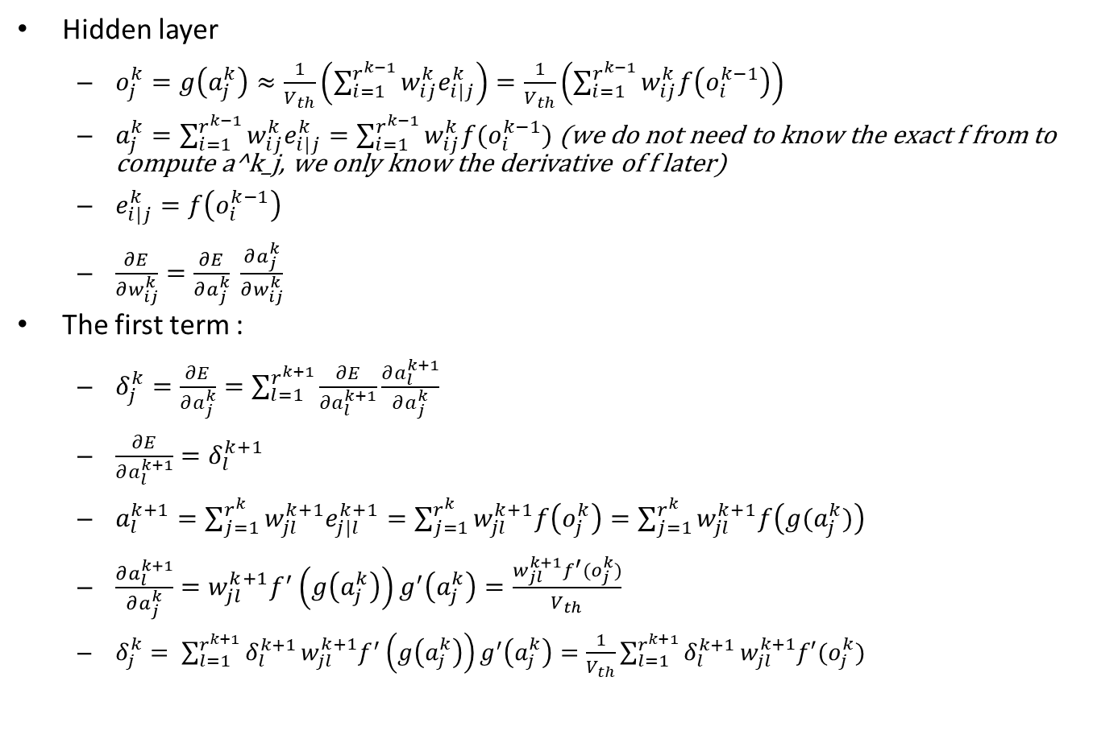
How to do backprop in SNN?
Hidden layer
$o_{j}^{k}=g\left(a_{j}^{k}\right)≈\frac{1}{V_{th}}\left(\sum_{i=1}^{r^{k−1}}{w_{ij}^{k}e_{i|j}^{k}}\right)=\frac{1}{V_{th}}\left(\sum_{i=1}^{r^{k−1}}{w_{ij}^{k}f\left(o_{i}^{k−1}\right)}\right)$
$a_{j}^{k}=\sum_{i=1}^{r^{k−1}}{w_{ij}^{k}e_{i|j}^{k}}=\sum_{i=1}^{r^{k−1}}{w_{ij}^{k}f(o_{i}^{k−1})}$ (we do not need to know the exact f from to compute a^k_j, we only know the derivative of f later)
$e_{i|j}^{k}=f\left(o_{i}^{k−1}\right)$
$\frac{∂E}{∂w_{ij}^{k}}=\frac{∂E}{∂a_{j}^{k}} \frac{∂a_{j}^{k}}{∂w_{ij}^{k}}$
The first term :
$δ_{j}^{k}=\frac{∂E}{∂a_{j}^{k}}=\sum_{l=1}^{r^{k+1}}{\frac{∂E}{∂a_{l}^{k+1}}}\frac{∂a_{l}^{k+1}}{∂a_{j}^{k}}$
$\frac{∂E}{∂a_{l}^{k+1}}=δ_{l}^{k+1}$
$a_{l}^{k+1}=\sum_{j=1}^{r^{k}}{w_{jl}^{k+1}e_{j|l}^{k+1}}=\sum_{j=1}^{r^{k}}{w_{jl}^{k+1}f\left(o_{j}^{k}\right)}=\sum_{j=1}^{r^{k}}{w_{jl}^{k+1}f\left(g(a_{j}^{k})\right)}$
$\frac{∂a_{l}^{k+1}}{∂a_{j}^{k}}=w_{jl}^{k+1}f^{′}\left(g\left(a_{j}^{k}\right)\right)g^{′}\left(a_{j}^{k}\right)=\frac{w_{jl}^{k+1}f^{′}(o_{j}^{k})}{V_{th}}$
$δ_{j}^{k}= \sum_{l=1}^{r^{k+1}}{δ_{l}^{k+1}}w_{jl}^{k+1}f^{′}\left(g\left(a_{j}^{k}\right)\right)g^{′}\left(a_{j}^{k}\right)=\frac{1}{V_{th}}\sum_{l=1}^{r^{k+1}}{δ_{l}^{k+1}}w_{jl}^{k+1}f′(o_{j}^{k})$
$$k$$
$$o_{i}^{k−1}$$
$$a_{j}^{k}$$
$$w_{ij}^{k}$$
$$o_{j}^{k}$$
$$δ_{j}^{k}$$
$$i$$
$$e_{i|j}^{k}$$
$$j$$
$$s_{i}^{k−1}$$
$$s_{j}^{k}$$

Slide 11
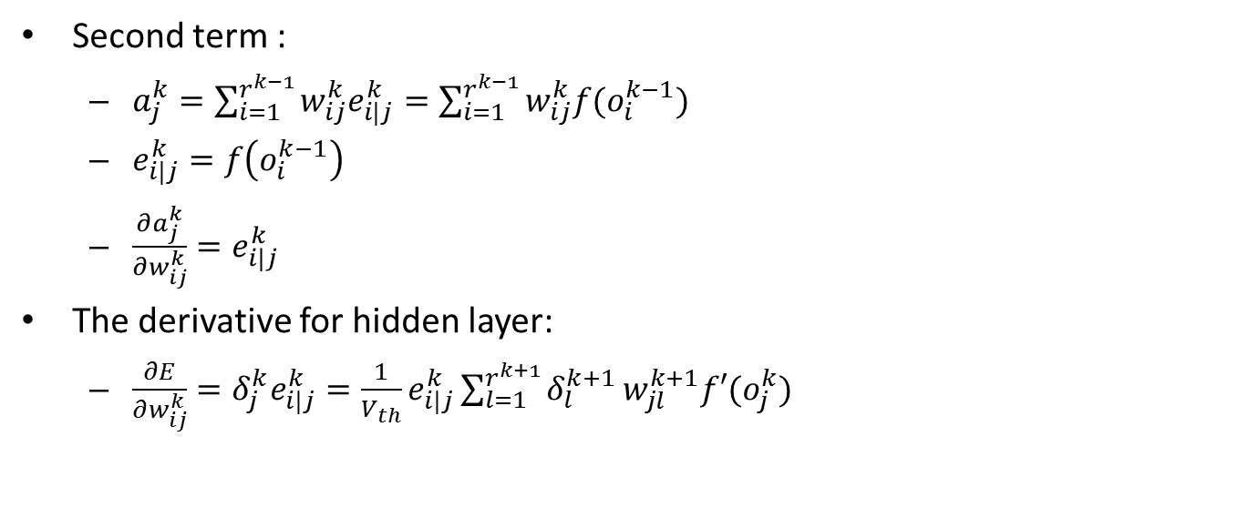
How to do backprop in SNN?
Second term :
$a_{j}^{k}=\sum_{i=1}^{r^{k−1}}{w_{ij}^{k}e_{i|j}^{k}}=\sum_{i=1}^{r^{k−1}}{w_{ij}^{k}f(o_{i}^{k−1})}$
$e_{i|j}^{k}=f\left(o_{i}^{k−1}\right)$
$\frac{∂a_{j}^{k}}{∂w_{ij}^{k}}=e_{i|j}^{k}$
The derivative for hidden layer:
$\frac{∂E}{∂w_{ij}^{k}}=δ_{j}^{k}e_{i|j}^{k}=\frac{1}{V_{th}}e_{i|j}^{k}\sum_{l=1}^{r^{k+1}}{δ_{l}^{k+1}}w_{jl}^{k+1}f′(o_{j}^{k})$
Back-propagated error in SNN
$$k$$
$$o_{i}^{k−1}$$
$$a_{j}^{k}$$
$$w_{ij}^{k}$$
$$o_{j}^{k}$$
$$δ_{j}^{k}$$
$$i$$
$$e_{i|j}^{k}$$
$$j$$
$$s_{i}^{k−1}$$
$$s_{j}^{k}$$

Slide 12

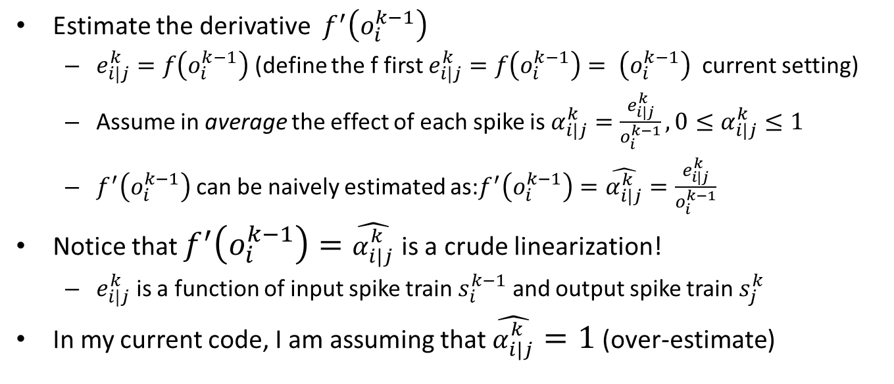
How to do backprop in SNN?
Estimate the derivative $f^{′}\left(o_{i}^{k−1}\right)$
$e_{i|j}^{k}=f\left(o_{i}^{k−1}\right)$ (define the f first $e_{i|j}^{k}=f\left(o_{i}^{k−1}\right)= \left(o_{i}^{k−1}\right)$ current setting)
Assume in average the effect of each spike is $α_{i|j}^{k}=\frac{e_{i|j}^{k}}{o_{i}^{k−1}}, 0≤α_{i|j}^{k}≤1$
$f^{′}\left(o_{i}^{k−1}\right)$can be naively estimated as:$f^{′}\left(o_{i}^{k−1}\right)=\hat{α_{i|j}^{k}}=\frac{e_{i|j}^{k}}{o_{i}^{k−1}}$
Notice that $f^{′}\left(o_{i}^{k−1}\right)=\hat{α_{i|j}^{k}}$ is a crude linearization!
$e_{i|j}^{k}$ is a function of input spike train $s_{i}^{k−1}$ and output spike train $s_{j}^{k}$
In my current code, I am assuming that $\hat{α_{i|j}^{k}}=1$ (over-estimate)
$$k$$
$$o_{i}^{k−1}$$
$$a_{j}^{k}$$
$$w_{ij}^{k}$$
$$o_{j}^{k}$$
$$δ_{j}^{k}$$
$$i$$
$$e_{i|j}^{k}$$
$$j$$
$$s_{i}^{k−1}$$
$$s_{j}^{k}$$

Slide 13
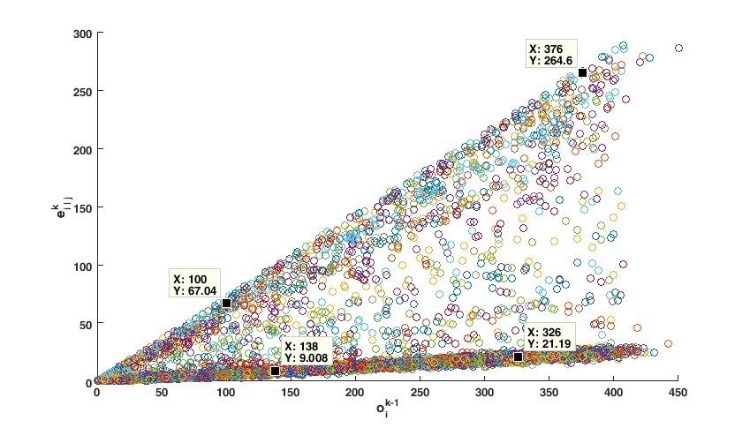


How to do backprop in SNN?
The plot of $e_{i|j}^{k}=f\left(o_{i}^{k−1}\right)$
$$k$$
$$o_{i}^{k−1}$$
$$a_{j}^{k}$$
$$w_{ij}^{k}$$
$$o_{j}^{k}$$
$$δ_{j}^{k}$$
$$i$$
$$e_{i|j}^{k}$$
$$j$$
$$s_{i}^{k−1}$$
$$s_{j}^{k}$$

Slide 14
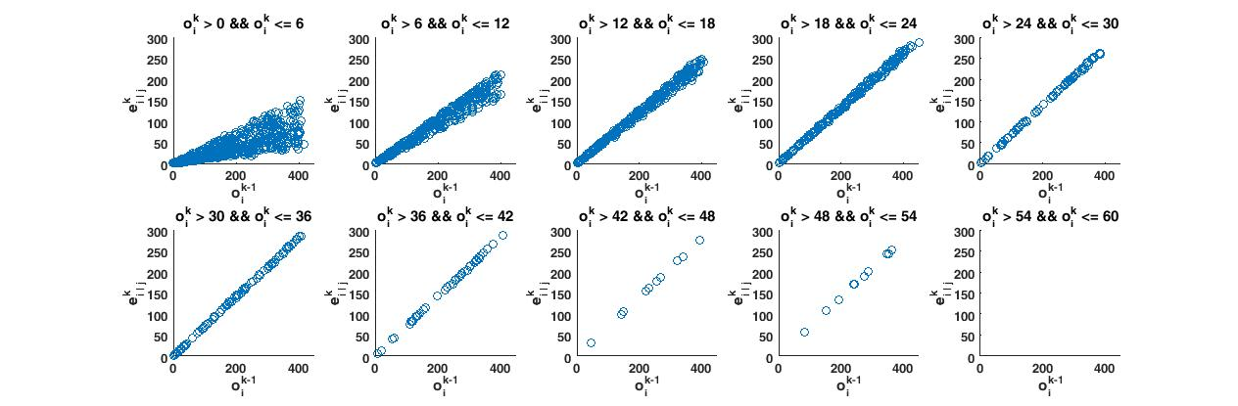

How to do backprop in SNN?
The plot of $e_{i|j}^{k}=f\left(o_{i}^{k−1}\right)$
$$k$$
$$o_{i}^{k−1}$$
$$a_{j}^{k}$$
$$w_{ij}^{k}$$
$$o_{j}^{k}$$
$$δ_{j}^{k}$$
$$i$$
$$e_{i|j}^{k}$$
$$j$$
$$s_{i}^{k−1}$$
$$s_{j}^{k}$$

Slide 15
Estimations:
Neglect all the timing information for pre/post spike trains
Leakage is neglected by set \alpha = 1
Questions:
Finding the derivatives for firing counts w.r.t. weight changes (both timing and rate information is required)
Limitations:
Timing information is still neglected

Slide 16
Direct comparison
Simulation \delta w up/down, see the firing counts (might go up/ down)
Try to match the simulated derivatives with our estimated derivatives
Theoretically show?
Numerically simulation for sensitivity of the f function w.r.t to time shift and fire count increase

Slide 17
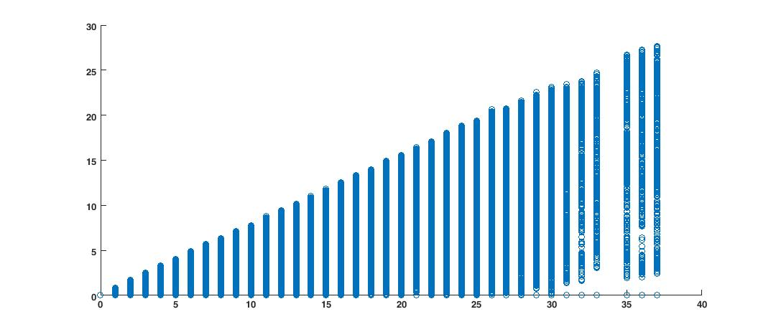




How to do backprop in SNN?
The plot of $e_{i|j}^{k}=f\left(o_{i}^{k−1}\right)$ for N-MNIST dataset
$$e_{i|j}^{k}$$
$$k$$
$$o_{i}^{k−1}$$
$$o_{i}^{k−1}$$
$$a_{j}^{k}$$
$$w_{ij}^{k}$$
$$o_{j}^{k}$$
$$δ_{j}^{k}$$
$$i$$
$$e_{i|j}^{k}$$
$$j$$
$$s_{i}^{k−1}$$
$$s_{j}^{k}$$

Slide 18
Several Tuning “Tricks”
Dynamic threshold (Tried)
No performance improvement
Add Bias Neuron (Tried)
Little performance improvement
Laterial Inhibition (Tried)
Weight Regularization (Tried)
Dedicated ways of weight initialization(On-going)
SGD(Tried)
Helpful

Slide 19
On-going efforts (Dec. 4)
Matching the SNN to DNN
Softmax – works for batch processing in GPU.
Pros: fast
Cons: the performance is not impressive.
Try to match the update levels of the gradients.
Want to make batch processing works for original simple objective function
Research on why performance is SNN is worse than DNN?
“Dead” neurons hinders the error-backprop
Need to tune the Vth.
Add artificial spike trains for training purpose.
Digging into the existing setting
The spikes count of the dataset is small! (sparse spikes)
More in-depth tuning needed.

Slide 20
On-going efforts (Dec. 12)
Batch Processing in GPU
Fix one “bug” in GPU related to batch processing.
The performance gets better (75% v.s. 10%), but it is still bad
Batch process might not work well for SNN?
Research on why performance is SNN is worse than DNN?
Silent neurons hinders the error-backprop?
Tuning the Vth, but not much insight obtained
Allow the gradient for pre-synaptic neurons of silent neuron
This is equivalent to change the Relu to Leaky-Relu
Little performance improvement obtained
Lateral inhibition
Works when only add to the output layer.
Help the SNN converge faster
No more modification of the existing rule needed if only added to the final layer

Slide 21
On-going efforts (Dec. 20)
Lateral inhibition
Works when only add to the output layer.
Help the SNN converge faster
Slightly modify the update to incorporate the effect of lateral inhibition
Slightly better results achieved
Re-derive the entire rule
Run experiments on the effect ratio included cases.
Still wait for results

Slide 22
Next Steps (Dec. 20)
Look into the dataset of N-MNIST
Find out why the performance is not as good as the MNIST
Set up the experiments for Spiking CNN
Try Adam in the near future
Dig into theory (Spiking Neuron Models)
Better understand the SNN

Slide 23
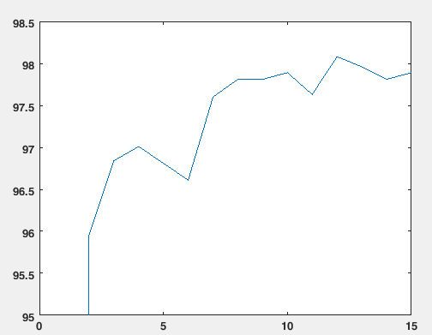
Performance Demo (“Current best setting”MNIST)

